Slide 1
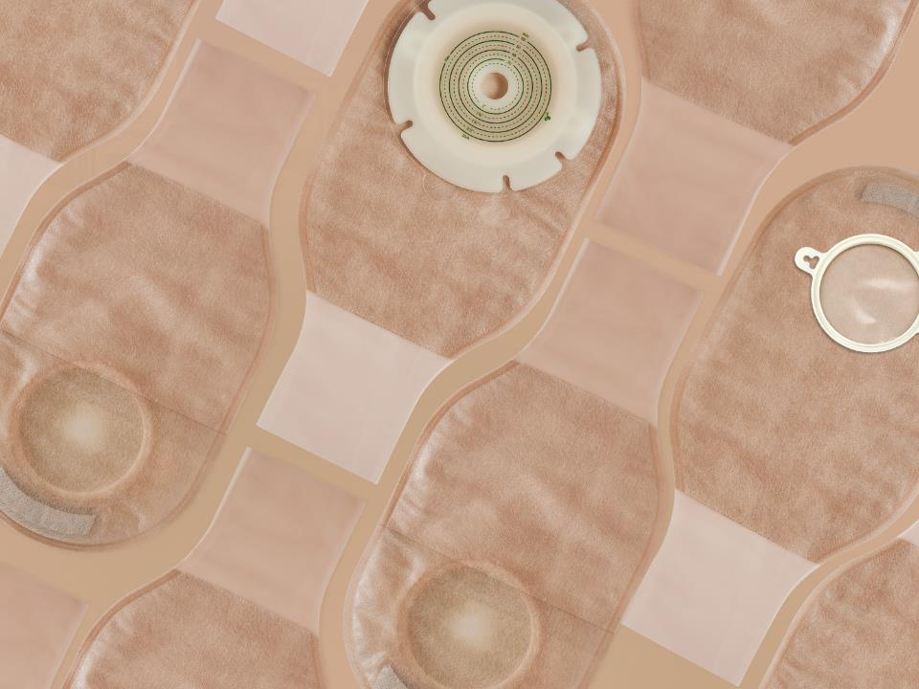

Ostomy Care Series
One-Piece Urostomy System
Shanghai Joy Crown Industry Co., Ltd

Slide 2


What is an ostomy?
People who have ostomy surgery, usually with disease or cancer of the large bowel or rectum. During clinical treatment, an opening in the abdomen will be surgically used as a drainage channel to replace the anus. This opening is called an artificial stoma or artificial anus, it is called a stoma.
If an artificial stoma is made due to a disease of the urinary system, it is called a urostomy.

Slide 3
What is an ostomy bag?
According to the different stoma, the ostomy bag can be divided into Colostomy bag and urostomy bag.
An ostomy bag is used to store feces excreted by a stoma patient through the stoma，The ostomy bag is composed of a barrier and a bag body, the barrier makes the ostomy bag stick to the human body, and the bag body is used to store feces.
The bag body and barrier can be one piece, which is called a one-piece ostomy bag. The bag body and barrier can also be split, which is called a two-piece ostomy bag.
The ostomy bag can be divided into an open pocket and a closed pocket. The open pocket can discharge feces at any time through the opening of the bag body, and the closed pocket can be discarded when it is full, which is convenient to use.

Slide 4

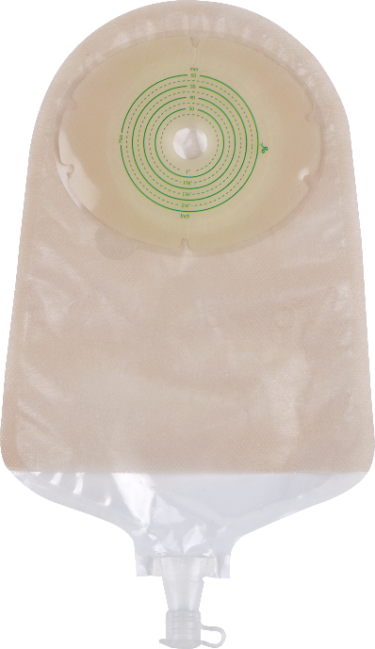
The Characteristics And Advantages Of Urostomy Bag
Hydrocolloid barrier with unique formula and special design
Soft and comfortable ultra-thin non-woven outer lining
Flexible, Sealed bag
Drain valve, good airtightness, no leakage
Hydrocolloid Barrier
Outer Lining Non-woven Fabric
The Bag Body
The experiment shows that the product is frmly pasted and is not afraid of leakage
The Drain Valve

Slide 5
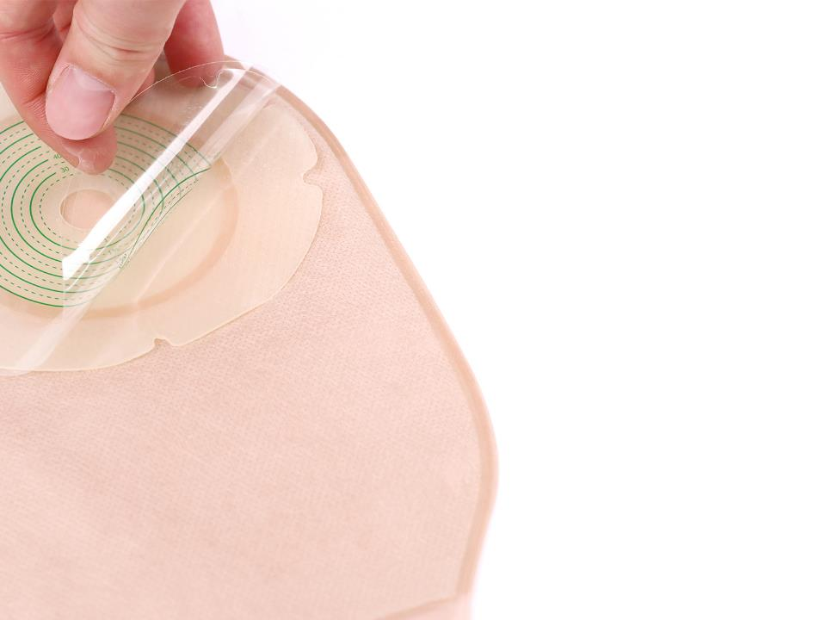
Hydrocolloid Barrier
Using medical hydrocolloid material, with no irritation and extremely low allergy rate.
Special hydrocolloid formula, with strong adhesive and safe and reliable.
Soft and comfortable, with radial incisions designed to conform to wrinkled skin with physical activity.
Easy to replace and clean.
Effectively absorbs the sweat produced by the skin, keeps it fresh and does not irritate the skin.

Slide 6
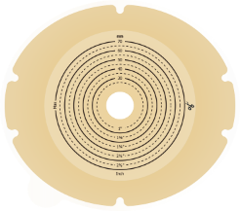
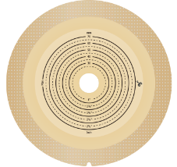
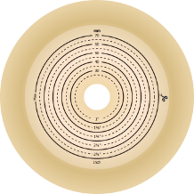
Three Barrier Styles To Fit Every Type Of Stoma
Hydrocolloid barrier
Hydrocolloid barrier
with tape border
Convex barrier

Slide 7
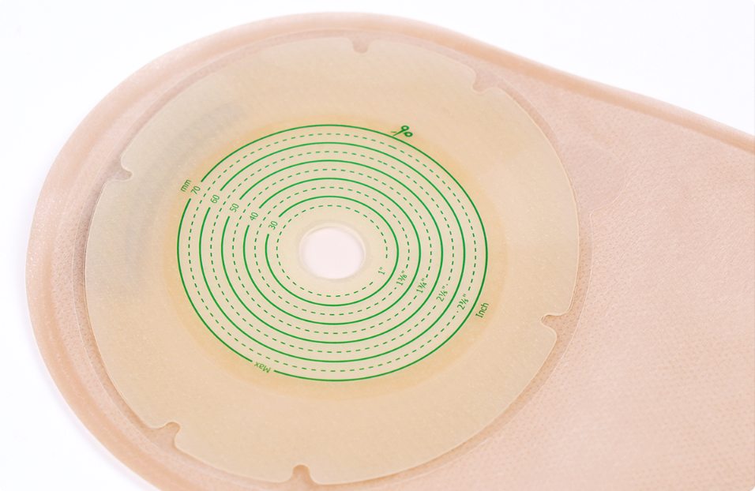
Hydrocolloid Barrier

Slide 8
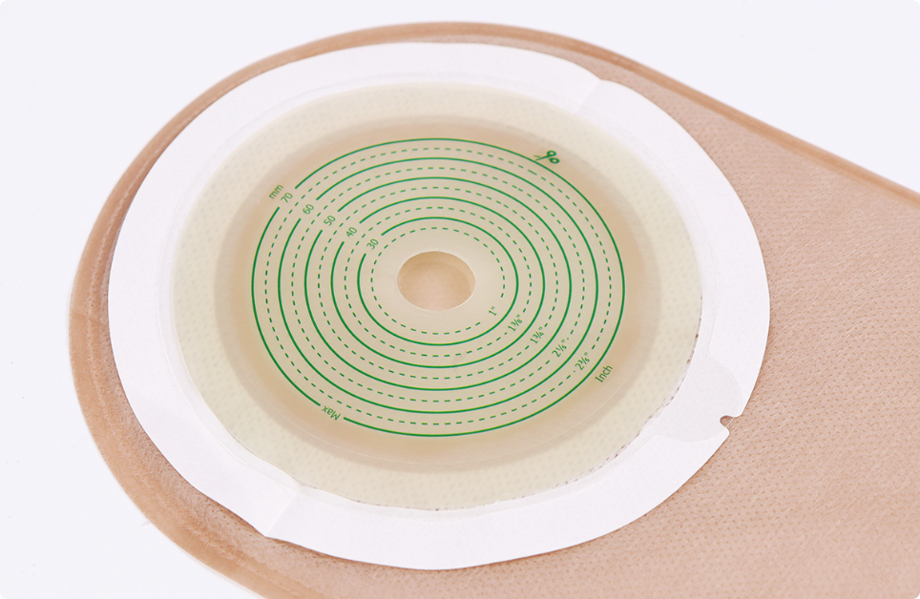
Hydrocolloid Barrier With Tape Border

Slide 9
Convex barrier

Slide 10

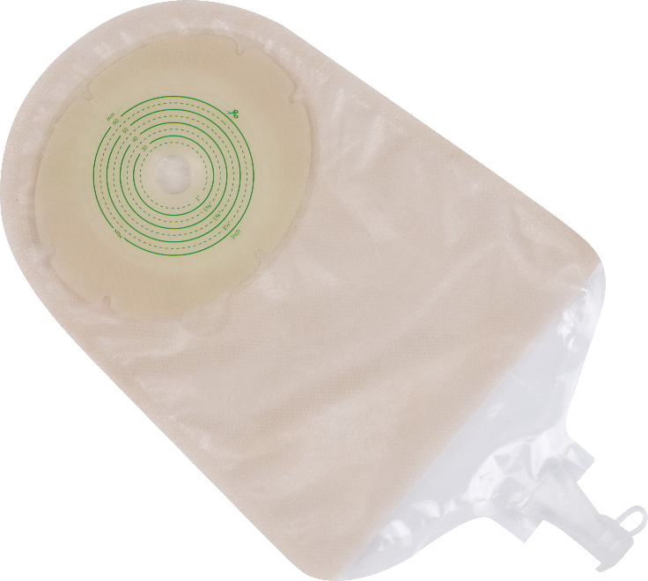
The Bag Body
* High barrier film, soft and strong
*Good airtightness and no leakage

Slide 11





A Variety Of Bag Styles Are Available For Patients Of Different Ages
Neonate
Children
Adult
Larger Size

Slide 12
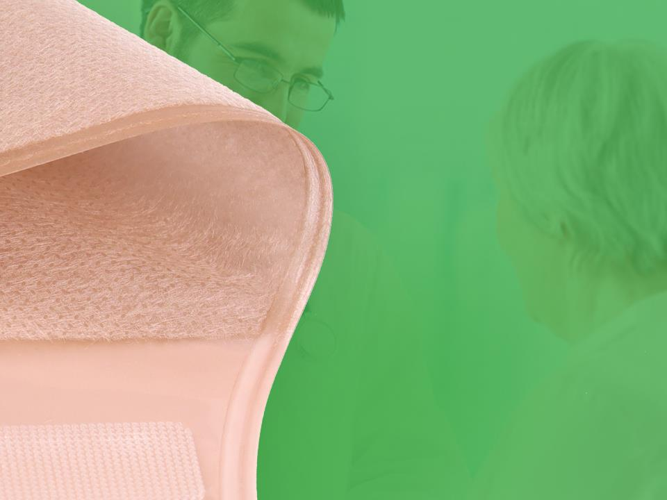
Outer Lining Non-woven
Fabric
Ultra-thin non-woven fabric, soft and comfortable
Waterproof fabric that stays fresh for a long time
Two colors available: skin color and white color

Slide 13
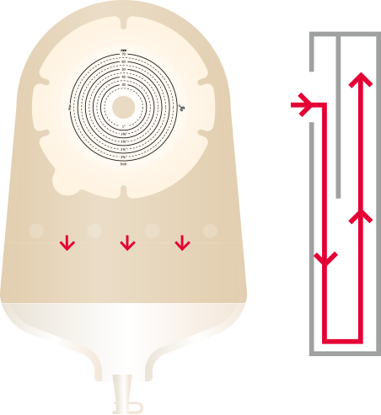
Schematic Diagram Of Anti-backflow Device
The anti-reflux device can prevent urine from flowing back to the top of the stoma bag and erode the skin around the stoma, effectively avoiding skin allergies and ulcers caused by soaking the skin around the stoma, and ensuring the comfort of use.

Slide 14

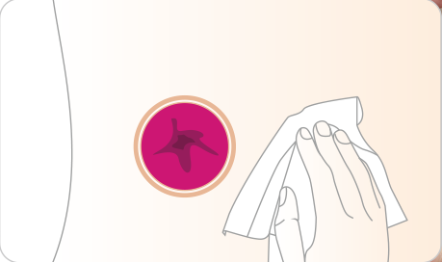
User Guide For One-piece Urostomy Bag
1. Wash the skin around the stoma with warm water or
saline and wait for the skin to dry

Slide 15
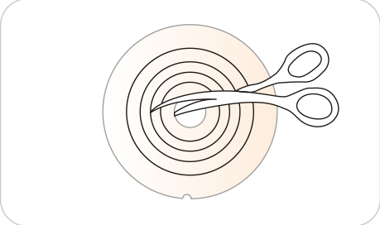
User Guide For One-piece Urostomy Bag
2. Measure your stoma and cut the barrier to the appropriate size/shape.

Slide 16
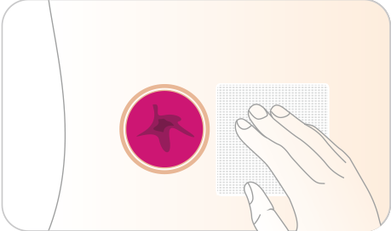
User Guide For One-piece Urostomy Bag
3. You can choose to place gauze on the stoma to prevent feces and exudates from flowing out when pasting the hydrocolloid barrier.

Slide 17
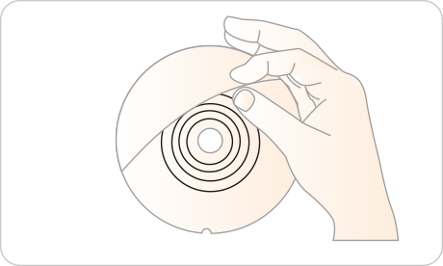
User Guide For One-piece Urostomy Bag
4. Peel off the PET protective film from the barrier to
expose the hydrocolloid adhesive.

Slide 18
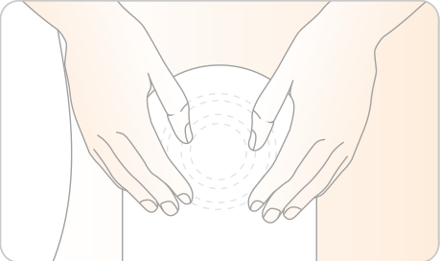
User Guide For One-piece Urostomy Bag
5. Let a small amount of air enter the bag to prevent the
ostomy bag from sticking together during use. Align
the hydrocolloid barrier with the stoma and apply
pressure so that it adheres completely to the skin.

Slide 19
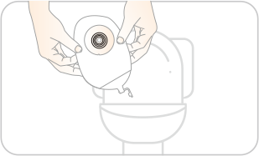
User Guide For One-piece Urostomy Bag
6. Unplug the drain valve, empty the urine on the toilet,
close the drain valve again, and continue using the
urostomy bag.

Slide 20
Caution
1. It is used in patients with a urostomy.
2. Usually it can be used for 1 to 3 days, continuous use will affect the adhesion ability, it is recommended to replace it every day
3. Urostomy bag can not be recycled.
4. The urostomy bag should not be thrown directly into the toilet or sewer, nor should it be discarded casually. Please pay attention to environmental protection.
5. Patients allergenic to adhesive should use it with caution.

Slide 21

THANK YOU!
Shanghai Joy Crown Industry Co., Ltd

